Slide 1
SCC204 Software Design
Use Cases-Example
Zhang Jinyu
(zjy@bjtu.edu.cn)

Slide 2
Use Cases (revisit)
A way to structure (detailed) requirements
Structure according to stakeholder needs
They are good because:
They describe “scenarios” or sample execution scenarios for the system under development, which are easy to understand
They are mainly textual so easy to use as a way to communicate between different stakeholders
They offer a way to transition into architectural design
They can be used to derive test cases

Slide 3
Functional use cases
Include is used to extract use case fragments that are duplicated in multiple use cases
Include用于提取多个重复的用例片段用例
Facebook
包含谁，指向谁
<<include>>
Accept Terms
Of Service
Create
Account
必须
<<extend>>
Edit Privacy
Settings
Facebook
User
选择性
Facebook
Admin
Upload Photo
Maintain
Facebook
Add Friend
Another
Facebook User
<<include>>
Add Application
谁用，指向谁
Extend is used when a use case conditionally adds steps to another use case
Application
Provider
当用例有条件地向另一个用例添加步骤时，使用Extend

Slide 4
Use case name: | Create Account
Scope: | Facebook
Primary actor: | Facebook User
Secondary actors: | None
Summary: | Facebook User intends to create a new facebook account
Preconditions: | Facebook User is at the facebook website
Main success scenario: | Facebook User enters user details (name, email, password, sex, DOB) into Facebook and requests signup Facebook validates user details & presents terms of service Facebook User Accepts Terms of Service Facebook creates user account and asks Facebook User to create a profile Facebook User enters profile information Facebook stores profile information and presents welcome page to Facebook User
Alternatives: | 5a.1 Facebook User defers profile 5a.2 Facebook presents welcome page to Facebook User
Exceptions: | 2a. User details cannot be validated. Registration is denied
Postconditions: | Facebook User has a registered facebook account
属于谁
同意
建立
推迟

Slide 5
Exercise
Write down the use cases for:
Add Friend
Add Application

Slide 6
Use case name: | Add Friend
Scope: | Facebook
Primary actor: | Facebook User
Secondary actors: | Another Facebook User
Summary: | Facebook User intends to add Another Facebook User as a friend
Preconditions: | Facebook User is logged in
Main success scenario: | Facebook User requests a list of potential friends Facebook suggests potential friends Facebook User selects a friend, Another Facebook User, to add Facebook informs Facebook User that it will need to confirm with Another Facebook User first Facebook contacts Another Facebook User Another Facebook User confirms friendship with Facebook User Facebook notifies Facebook User and adds Another Facebook User to his/her friend list
Alternatives: | 1a: Facebook User searches for potential friends using keywords 3a: (additional step) After selecting a friend, Facebook User adds a personal welcome message
Exceptions: | 6a: Another Facebook User chooses to ignore. End.
Postconditions: | Facebook User is friends with Another Facebook User
表明身份

Slide 7
Use case name: | Add Application
Scope: | Facebook
Primary actor: | Facebook User
Secondary actors: | Application Provider
Summary: | Facebook User wishes to add a new application to his/her profile
Preconditions: | Facebook User is logged in and has chosen the application to add
Main success scenario: | Facebook User requests application to be added Facebook prompts Facebook User to give permission for application to access his/her profile Facebook User grants permission Facebook adds application from Application Provider to profile Application Provider accesses Facebook User’s profile and starts
Alternatives: | 2a: Application is a facebook app, not from a 3rd party. Therefore no need for permission rights. Goto 4.
Exceptions: | 3a: Facebook User denies permission. End without adding app. 4a: Application Provider cannot be contacted even after multiple (5 times) tries. End without adding app.
Postconditions: | Chosen application added to Facebook User’s profile
a表示另一个选择

Slide 8
Use Case Guidelines
多个if--else-
Avoid Excessive Structuring
Avoid Functional Decomposition
Use Cases in Testing
Non-functional requirements
不用写

Slide 9
Avoid Excessive Structuring
<<include>>
Log in
Add Friend
<<include>>
Add Application
Understand the difference between include and extend
Only use when absolutely necessary
Create
Account
<<extend>>
Edit Privacy
Settings

Slide 10
Avoid Functional Decomposition
Enter password
Enter sex and DOB
Enter username
Accept Terms of Service
Give Permission to
Application
Facebook User
Enter Profile
Information
Request Add Application

Slide 11
Much better…
Create Account
Facebook User
Add Application

Slide 12
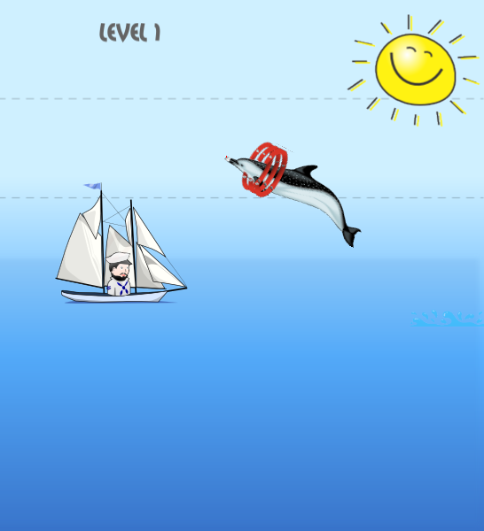
Rule of thumb for level of granularity
高度
Alistair Cockburn notes that use cases can be written at different levels of detail
Cloud
老板
我们
Sea-level
总体，细节
Fish
草
Bottom of the ocean
细节

Slide 13
4 levels of use cases
决定方向
Cloud level. Very high level summary. Typically a business goal.
Sea level. Or user goal. Key characteristics: single sitting & user gets a result
Fish level. Usually the included or extending use cases
Bottom-of-the-ocean level. Too low!
team leader
Examples:
Cloud level. Sell Books Online
Sea level. Buy Book
Fish level. Login
Bottom-of-the-ocean level. Check password.
流程

Slide 14
Exercise
For facebook, come up with one example for each of the four levels

Slide 15
Possible Answer
Cloud:
Maximize number of users
Maintain Reputation
Secure User’s Private Data
Sea:
Add Application
Add Friend
Create Account
Fish:
Login
Accept Terms of Service
Bottom-of-Ocean
Enter Password
Click on “submit”

Slide 16
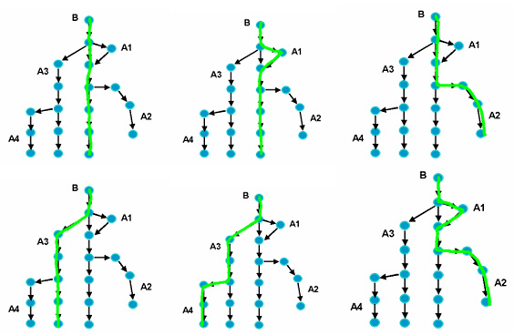
Use Cases in Testing
Create (at least) one test case for each flow
Image from: http://www.ibm.com/developerworks/rational/library/04/r-3217/index.html?S_TACT=105AGX15&S_CMP=EDU

Slide 17
Use Cases in Testing
参数
Identify variables for each use case step
Identify significantly different options for each variable
Combine options to be tested into test cases
Assign values for variables
For more detail, see http://www.ibm.com/developerworks/rational/library/04/r-3217/index.html?S_TACT=105AGX15&S_CMP=EDU

Slide 18
Use case name: | Create Account
Scope: | Facebook
Primary actor: | Facebook User
Secondary actors: | None
Summary: | Facebook User intends to create a new facebook account
Preconditions: | Facebook User is at the facebook website
Main success scenario: | Facebook User enters user details (name, email, password, sex, DOB) into Facebook and requests signup Facebook validates user details & presents terms of service Facebook User Accepts Terms of Service Facebook creates user account and asks Facebook User to create a profile Facebook User enters profile information Facebook stores profile information and presents welcome page to Facebook User
Alternatives: | 5a.1 Facebook User defers profile 5a.2 Facebook presents welcome page to Facebook User
Exceptions: | 2a. User details cannot be validated. Registration is denied
Postconditions: | Facebook User has a registered facebook account
1 2 3 4 5 6
1 2a 3 4 5a.1 6
Notes:
How many test cases to test this use case? 4

Slide 19
Non-functional Requirements
Do not appear (explicitly) in use cases
They are a major reason why detractors criticise use cases
However, simple annotations can be used to add them in most cases
Facebook e.g.:
NFR1: All data stored by facebook must respect the privacy permissions set by the user
NFR2: Facebook should support 300 million active users with a growth rate of 1 million per month

Slide 20
NFR1
Facebook
Accept Terms
Of Service
Create
Account
<<include>>
NFR1
<<extend>>
Edit Privacy
Settings
Facebook
User
Facebook
Admin
Upload Photo
Maintain
Facebook
Add Friend
Another
Facebook User
Add Application
Application
Provider

Slide 21
NFR2
Facebook
Accept Terms
Of Service
Create
Account
<<include>>
NFR2
<<extend>>
Edit Privacy
Settings
Facebook
User
Facebook
Admin
Upload Photo
Maintain
Facebook
Add Friend
Another
Facebook User
Add Application
Application
Provider

Slide 22
Resources
Good exemplar of industrial-strength use case document:
http://www.cs.mcgill.ca/~joerg/taosd/TAOSD/TAOSD_files/AOM_Case_Study.pdf
Use cases used in acceptance testing:
http://www.ibm.com/developerworks/rational/library/04/r-3217/index.html?S_TACT=105AGX15&S_CMP=EDU

Slide 23
?
Question

